Slide 1
Digital Marketing Project Phase 2

Slide 2
Team Leader : PULLATA PRAVALIKA Team member : TALE KALYANI Team member : TAMADA PUNYAVATHI Team member : VAVILAPALLI GEETHANJALI Team member : YADLA JAHNAVI

Slide 3



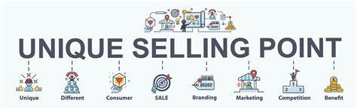
Part 1: Brand study, Competitor Analysis & Buyer’s/Audience’s Persona
Research Brand: TATA MOTORS
Mission/Values:Tata Motors focuses on innovation, sustainability, and customer satisfaction as their core values.
USP:Tata Motors' unique selling proposition (USP) lies in their commitment to producing high-quality vehicles at affordable prices.

Slide 4
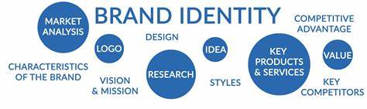

Analyze Brand Tone and Identity:Tata Motors' brand tone and identity can be described as reliable, innovative, and customer-centric. They strive to provide vehicles that meet the needs of their diverse customer base while maintaining a strong focus on quality and sustainability. Set 5 SMART goals and KPIs for the same:1. Goal: Increase brand awareness KPI: Measure social media engagement and reach (e.g., likes, shares, impressions). 2. Goal: Improve customer satisfaction KPI: Monitor customer feedback and ratings (e.g., customer surveys, online reviews). 3. Goal: Boost sales revenue KPI: Track monthly sales figures and revenue growth. 4. Goal: Enhance product innovation KPI: Measure the number of new vehicle models launched per year. 5. Goal: Increase market share KPI: Monitor market share percentage compared to competitors on a quarterly basis.By setting these SMART goals and tracking the corresponding KPIs, Tata Motors can measure their progress and make data-driven decisions to drive their brand forward.

Slide 5
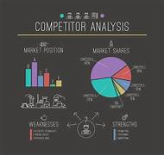
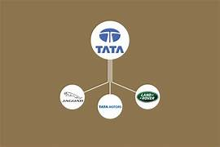
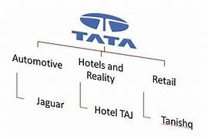
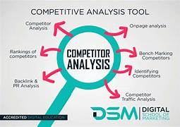
Part 1: Brand study, Competitor Analysis & Buyer’s/Audience’s Persona
Buyer's/Audience's Persona: Clearly define the target audience for the chosen brand. Consider demographics, psychographics, behaviors, and interests.
Tata Motors' target audience persona is diverse, including individuals and businesses looking for reliable, affordable, and innovative vehicles. They cater to both urban and rural markets, offering a wide range of products to meet various needs and preferences. Tata Motors aims to appeal to individuals seeking value for money, environmentally conscious consumers, and businesses looking for reliable fleet solutions.

Slide 6
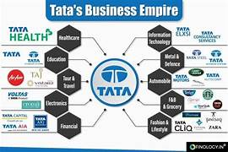
The target audience for Tata Motors brand includes individuals and businesses seeking reliable, affordable, and innovative vehicles. They cater to diverse markets, appealing to value-conscious consumers, environmentally conscious individuals, and businesses in need of reliable fleet solutions. Tata Motors aims to provide quality vehicles that meet the needs and preferences of their target audience. Tata Motors targets a wide range of demographics, including individuals from various age groups, income levels, and geographic locations. They cater to both urban and rural markets, providing vehicles that suit different lifestyles and preferences. Tata Motors' diverse product lineup ensures that they can appeal to a broad audience, from young professionals looking for their first car to families in need of spacious and reliable vehicles.

Slide 7
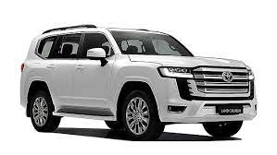
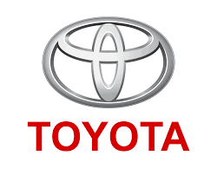
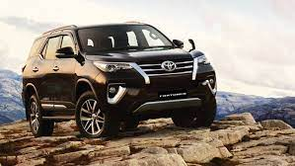
Part 1: Brand study, Competitor Analysis & Buyer’s/Audience’s Persona
Competitor Analysis: Select three competitors operating in the same industry or niche as the chosen brand, examine their USPs and online communication and conduct SWOT analysis
Competitor 1: Toyota - Unique Selling Proposition (USP): Known for their reliability, fuel efficiency, and advanced safety features. - Online Communication: Toyota emphasizes their commitment to sustainability, innovation, and customer satisfaction through engaging social media content and informative website resources. - SWOT Analysis of Tata Motors: - Strengths: Wide range of vehicle offerings, strong brand reputation, focus on affordability and innovation. - Weaknesses: Perception of lower quality compared to some competitors, limited market presence in certain regions. - Opportunities: Growing demand for electric vehicles, expanding into new international markets. - Threats: Intense competition in the automotive industry, changing consumer preferences and trends.

Slide 8
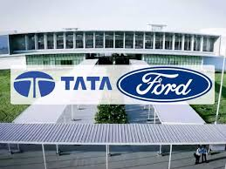
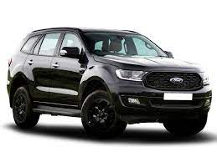
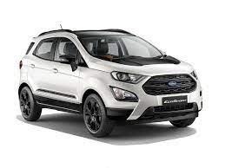
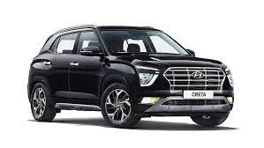
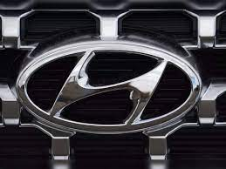
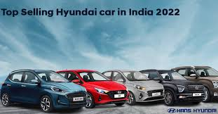
Competitor 2:Ford - USP: Known for their powerful performance, ruggedness, and iconic American heritage. - Online Communication: Ford utilizes social media platforms and their website to engage with customers, share stories of innovation and sustainability, and promote their commitment to safety and community involvement. - SWOT Analysis of Tata Motors: - Strengths: Strong presence in commercial vehicle segment, focus on innovation and technology, expanding global footprint. - Weaknesses: Perception of lower quality compared to some competitors, limited brand recognition in certain international markets. - Opportunities: Increasing demand for electric and hybrid vehicles, growing interest in connected car technologies. - Threats: Intense competition in the global automotive market, potential impact of economic fluctuations on consumer spending.
Competitor 3: Hyundai - USP: Known for their stylish designs, advanced technology features, and comprehensive warranty offerings. - Online Communication: Hyundai leverages social media platforms to showcase their latest vehicle models, highlight customer stories, and promote their commitment to sustainability and safety. - SWOT Analysis of Tata Motors: - Strengths: Diverse product portfolio, focus on affordability and value for money, strong presence in emerging markets. - Weaknesses: Perception of lower brand prestige compared to some competitors, limited market share in certain segments. - Opportunities: Expanding electric vehicle market, increasing demand for sustainable transportation solutions. - Threats: Intense competition from both domestic and international automotive brands, evolving government regulations.

Slide 9
Part 2: SEO & Keyword Research
SEO Audit: Do an SEO audit of the brands website
1.Website Optamization :
Evelute the websites loading speed and mobile-friendliness
Assess the website’s URL structure and ensure it is user- friendly and search engine-friendly.
2.Content analysis:
-review the website’s content for keyword usages , relevancy and quality.
-Ensure that the content is unique, engaging, and provides value to users.
-evaluate the presence of relevant internal and external links within the content.
3.Technical SEO:
Check for proper indexing of the website’s pages by search engines.
Review the website’s XML sitemap and robots. Txt file for proper configuration.
-Ensure that the website has a secure HTTPS connection and no broken links.
4.Local SEO:
-verify if the brand’s local listings (google my business, bing places) are accurate and up-to-date
-Assess the presence of contistent NAP (Name, Adress and Phone numbers)
.

Slide 10
Information across all online directories. Keyword Research: Define Research Objectives, Brainstorm Seed Keywords, Utilize Keyword Research Tools (SEMrush or Moz Keyword Explorer),Analyze Competitor Keywords, Long-tail Keyword Exploration (specific, longer phrases) that align with the research objectives and have lower competition but higher conversion potential. Branded Keywords: 1. Tata Motors 2. Tata Motors vehicles 3. Tata Motors car models 4. Tata Motors official website 5. Tata Motors dealershipsNon-Branded Keywords: 1. Electric vehicles in India 2. SUVs with good mileage 3. Affordable hatchback cars 4. Luxury sedans in India 5. Best car safety features On page Optimization: Meta Tag optimization & content optimization 1. Title Tag: Ensure each page has a unique, descriptive title tag that includes relevant keywords and accurately represents the content. 2. Meta Description: Write compelling meta descriptions that summarize the page's content and entice users to click through from search engine results. 3. Keywords: Incorporate relevant keywords naturally in the meta tags, but avoid keyword stuffing. Content Page Optimization: 1. Keyword Research: Conduct thorough keyword research to identify relevant keywords to target in your content. 2. Content Structure: Organize the content with clear headings, subheadings, and bullet points to enhance readability and user experience. 3. Keyword Placement: Incorporate targeted keywords in the page's headings, subheadings, and throughout the content while maintaining a natural flow. 4. High-Quality Content: Create unique, informative, and engaging content that provides value to users and encourages them to stay on the page. 5. Image Optimization: Optimize images by using descriptive filenames, alt tags, and compressing them for faster loading times. 6. Internal Linking: Include relevant internal links within the content to guide users to other valuable pages on the website. 7. User Experience: Ensure that the page is mobile-friendly, loads quickly, and provides a seamless browsing experience. Reflect on the process of conducting keyword research and the SEO recommendations provided. Document the challenges faced during the research and analysis phase, as well as the key insights gained from the keyword research process.

Slide 11
Part 3: Content Ideas and Marketing Strategies
Content Idea Generation & Strategy: Create a content calendar for the remaining month of October by brainstorming content themes, exploring various formats like blog posts, videos, infographics, podcasts, and interactive quizzes, and scheduling publication dates mainly on Facebook & Instagram. And include the strategy, aim and the idea behind these posts and story
EXAMPLE: Create a table with the strategy, aim and idea of each content piece

Slide 12
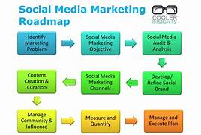
Part 3: Content Ideas and Marketing Strategies
Reflect on the content ideas and marketing strategies process, discussing the challenges encountered and lessons learned.
Social Media Marketing: Tata Motors uses social media platforms like Facebook, Instagram, and Twitter to promote its products and engage with customers. They share images and videos of their vehicles and also run social media campaigns to attract new customers.
1.Tata Motors:- Social media marketing strategies
The company uses social media to promote its brand values and share glimpses of how they contribute to the local community. They also discuss important issues and discuss the issue including gender equality, malnutrition, sanitation, and clean water, as well as other topics.They also use social media marketing strategy for e-commerce website.

Slide 13
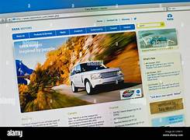
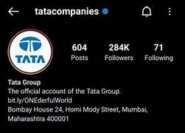
a)Tata Motors:- Instagram Marketing Strategies Tata Motors has over 242k followers on Instagram. Their bio states, “Tata Punch-Proud to be the Official Partner of Tata IPL 2022, to ensure relevance. Tata Motors’ Instagram follows a rigorous grid, with 9-post patterns on festivals and special occasions. In addition, they frequently post about their employees and their accomplishments. Most of their profiles are full of photos and videos of the products — vehicles. As per Phalanx, Tata Motors’ engagement on Instagram has been recorded as 0.40 percent. According to Phalanx, Tata Motors’ engagement rate is 0.40. Instagram marketing strategy is one of the best strategies they used. b)Tata Motors:- Facebook Marketing Strategies Tata Motors’ Facebook marketing strategies are a bit similar to the process of Instagram. However, you will need help finding grids with broken posts. The posts on Facebook also have captions in Hindi that get positive responses in comments. They have more than 450,000,028followers. A prominent aspect of Tata Motors’ Facebook is the comments. Many posts have negative comments regarding their services. Tata Motors, however, responds to all the words with the assurance of resolution. As per Phalanx, an engagement tool, Tata Motors’s Facebook engagement rates are 0.06 percent and also it is the best platform to create an E-commerce store. c)Tata Motors:- Twitter Marketing Strategies Tata Motors’ Twitter also features a significant number of posts in Hindi to appeal to the population of Hindi speakers in the nation. The company uses Twitter to announce and promote contests and other contests. Engagement (in terms of reshares and likes) is smaller on Twitter than on other platforms. 2.Tata Motors: Website Design Tata Group’s website Tata Group has a user-friendly website filled with intriguing content that draws a significant readership regularly. The website is an entire one-stop shop for all details about the business, including its history, segment-by-segment operation, new product launches, critical business news, and current job openings. The website’s improved responsiveness helps it to stay in the top position of results for search engines, which is a sign of efficient search engine Optimization (SEO). 3.Tata Motor’s Paid Marketing Strategies a)Facebook and Instagram Ads Tata Motors used social media websites such as Facebook and Instagram to advertise their clients and services to get the desired results. Through these advertisements, we could bring in new leads and then convert them into sales for autos. b)Google Ads Tata Motors made good use of Google ads to highlight the various features and styles of Tata Motors vehicles. This increased awareness among prospective customers. This drove more traffic to their website and led to the desired result.

Slide 14
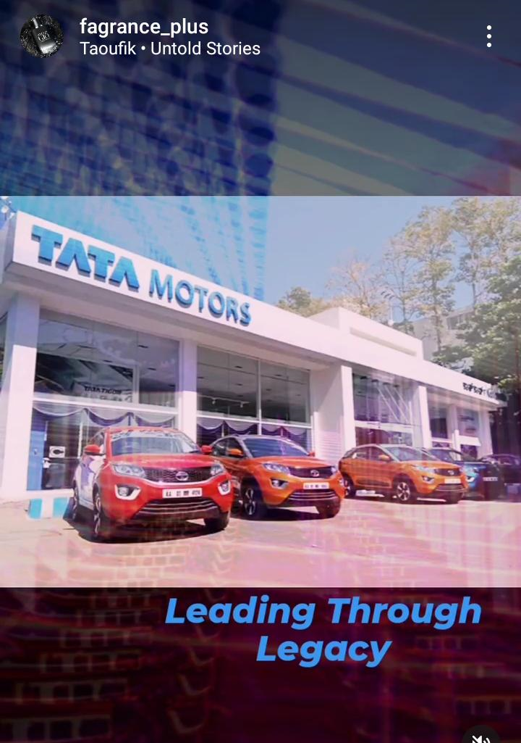
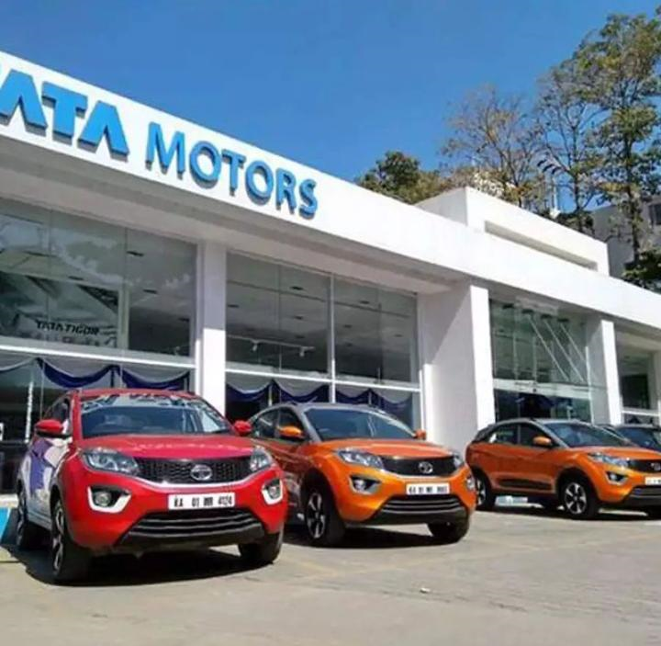
Part 4: Content Creation and Curation
Instagram Story
Note: Once done monitor the performance of the posts and Stories using the insight tool and analyze the engagement metrics (likes, comments, shares, impressions, etc.). Based on the analysis, mention the strategies and areas for improvement. Attach your screenshots (images/videos of the story) and add your account link url
Account Link https://instagram.com/fagrance_plus?utm_source=qr&igshid=YzU1NGVlODEzOA%3D%3D
Post link https://www.instagram.com/reel/CyQzzzYyN2H/?igshid=NjIwNzIyMDk2Mg==
Highlights link https://www.instagram.com/reel/CyQzzzYyN2H/?igshid=NjIwNzIyMDk2Mg==
Story link https://instagram.com/stories/fagrance_plus/3211299881864534753?utm_source=ig_story_item_share&igshid=M2MyMzgzODVlNw==

